Slide 1
Python Programming
-Rohit 27-01-2020

Slide 2
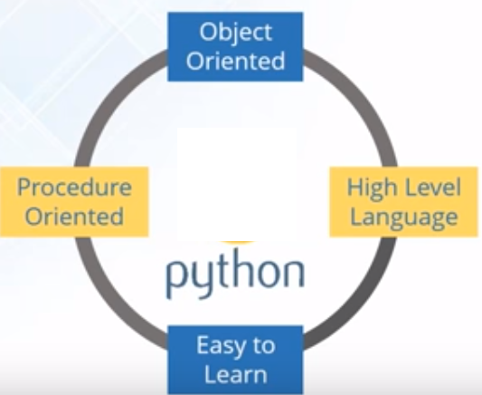
Python Introduction:
Python was created by Guido Rossum 1989 and is very easy to learn {But officially Python was made available to public in 1991. The official Date of Birth for Python is : Feb 20th 1991 }.
The name Python was selected from the TV Show "The Complete Monty Python's Circus", which was broadcasted in BBC from 1969 to 1974.
Python is an Interpreted , Object Oriented , high-level programming language with dynamic semantics

Slide 3
Who & Where -- Python:
YouTube
Google
Dropbox
Bit-Torrent
NASA
NETFLIX
Where we can use Python:
1. For developing Desktop Applications
2. For developing web Applications
3. For developing database Applications
4. For Network Programming
5. For developing games
6. For Data Analysis Applications – numpy, pandas, scikit etc.
7. For Machine Learning -
8. For developing Artificial Intelligence Applications
9. For IOT ...

Slide 4
Python Features
Simple and Easy to learn
Free and Open Source (Jython is customized version of Python to work with Java Applications)
High Level Language
Portable (Once we write a Python program, it can run on any platform without rewriting once again. Internally PVM is responsible to convert into machine understandable form)
Supports different Programming paradigm
Extensible
Note:- PVM (Python Virtual Machine)

Slide 5
Flavors of Python
CPython: It is the standard flavor of Python. It can be used to work with C language Applications.
Jython or JPython: It is for Java Applications. It can run on JVM
IronPython: It is for C#.Net platform
PyPy: The main advantage of PyPy is performance will be improved because JIT compiler is available inside PVM.
RubyPython : For Ruby Platforms
AnacondaPython It is specially designed for handling large volume of data processing.

Slide 6
Python Installation
http://www.python.org
https://www.anaconda.com/download/#windows

Slide 7
Installing Python 3.7.0
https://www.python.org/downloads/
The Python download requires about 25 Mb of disk space; keep it on your machine, in case you need to re-install Python.
When installed, Python requires about an additional 90 Mb of disk space.

Slide 8
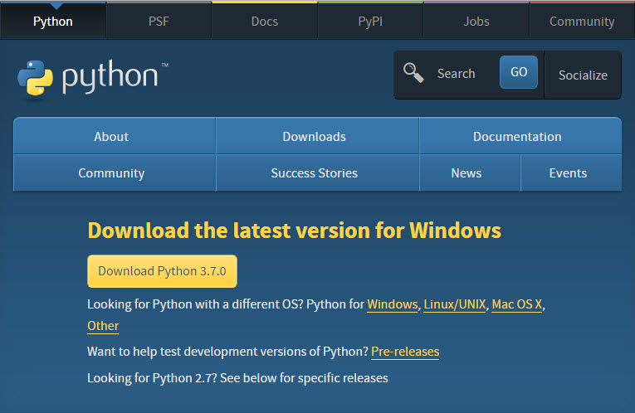
Go to: https://www.python.org/downloads/
Click the “Download Python 3.4.3 Button”

Slide 9
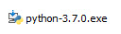
Downloading Python contd..
Click the Download Python 3.7.0 button. The file named python-3.7.0.exe should start downloading into your standard download folder. This file is about 30 Mb so it might take a while to download fully if you are on a slow internet connection (it took me about 10 seconds over a cable modem).
The file should appear as
Move this file to a more permanent location, so that you can install Python (and reinstall it easily later, if necessary).
Start the Installing instructions directly below.

Slide 10
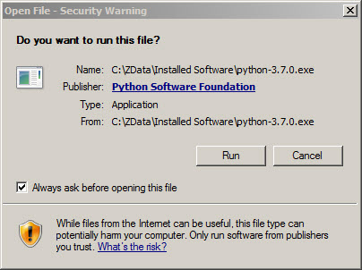
Installing python
Double-click the icon labeling the file python-3.7.0.exe.An Open File - Security Warning pop-up window will appear.
2. Click Run
A Python 3.7.0 (32-bit) Setup
pop-up window will appear.

Slide 11
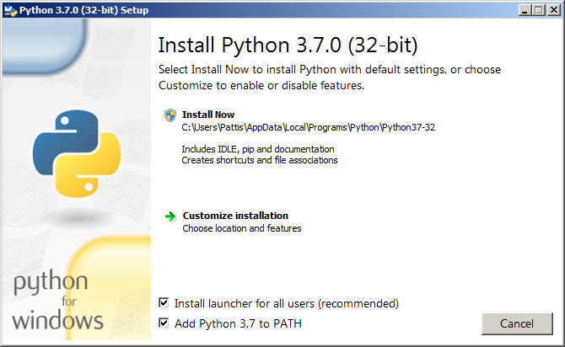
Ensure that the Install launcher for all users (recommended) and the Add Python 3.7 to PATH checkboxes at the bottom are checked.
If the Python Installer finds an earlier version of Python installed on your computer, the Install Now message may instead appear as Upgrade Now (and the checkboxes will not appear).

Slide 12
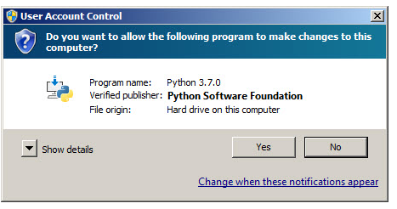
Python Installation
Highlight the Install Now (or Upgrade Now) message, and then click it.
A User Account Control pop-up window will appear, posing the question Do you want the allow the following program to make changes to this computer?
Click the Yes button. A new Python 3.7.0 (32-bit) Setup pop-up window will appear with a Setup Progress message and a progress bar.

Slide 13
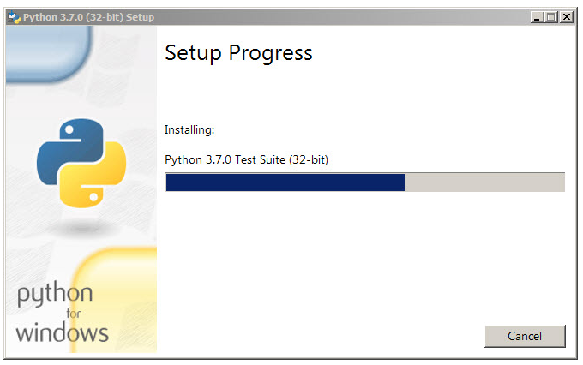
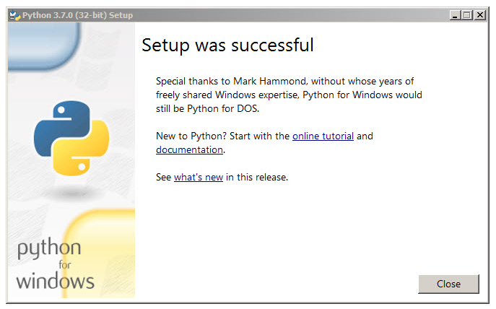
Installation Complete
During installation, it will show the various components it is installing and move the progress bar towards completion. Soon, a new Python 3.7.0 (32-bit) Setup pop-up window will appear with a Setup was successfully message.

Slide 14
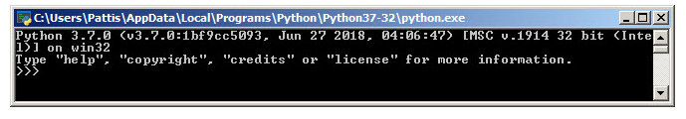
VERIFY PYTHON INSTALLATION
To try to verify installation, Navigate to the directory C:\Users\Raghu\AppData\Local\Programs\Python\Python37-32 (or to whatever directory Python was installed: see the pop-up window for Installing step 3).
Double-click the icon/file python.exe.The following pop-up window will appear.
You may now follow the instructions to download and install Java (you should have already installed Java, but if you haven't, it is OK to do so now, so long as you install both Python and Java before you install Eclipse), and then follows the instruction to download and install the Eclipse IDE.
Note: You need to download/install Java even if you are using Eclipse only for Python)

Slide 15
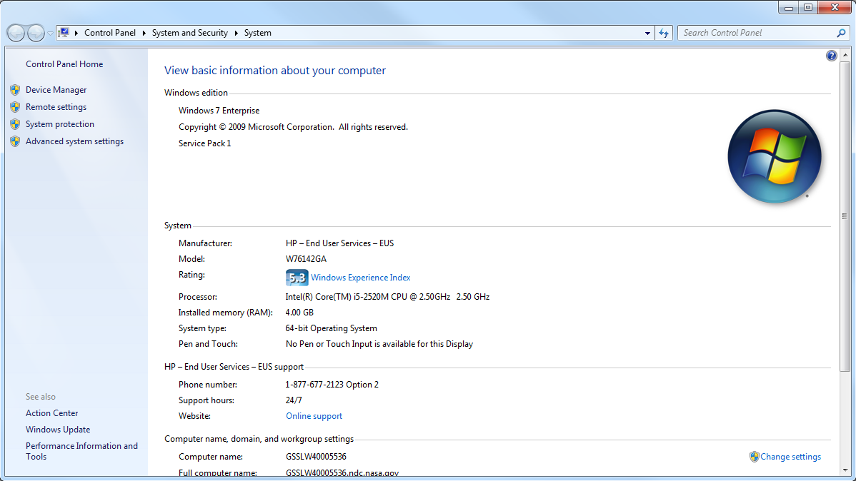

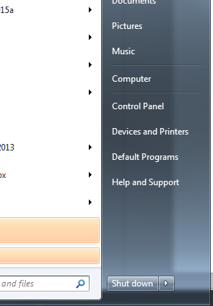
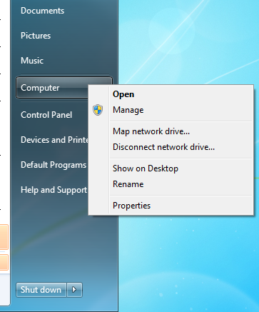
PATH ISSUE (PYTHON)
Open the start menu:
Click the “Advanced System Settings” Button
**RIGHT** click on the “Computer” Button
Click “Properties”

Slide 16
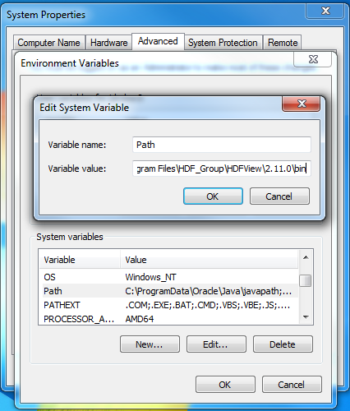
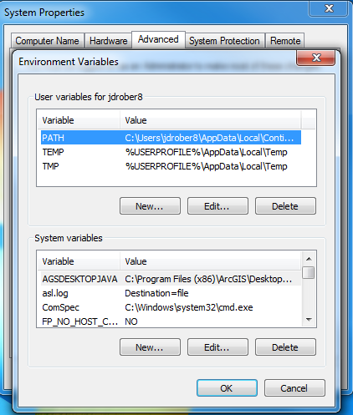
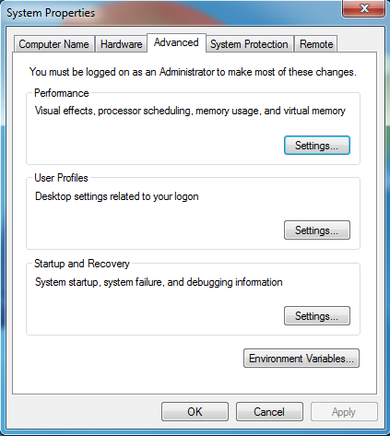
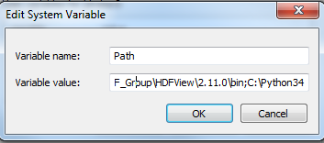
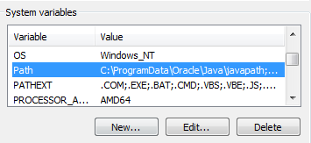
Setting your environment path
Scroll to the very end of this line of text…
Click “Ok” to all open properties windows
…and add the text: “;C:\Python34” to the end
Click on the variable “Path” so that it is highlighted, and then click “Edit..”
Go to the “System Variables” window, and scroll down until you find the “Path” variable
Click the “Environment Variables” Button

Slide 17
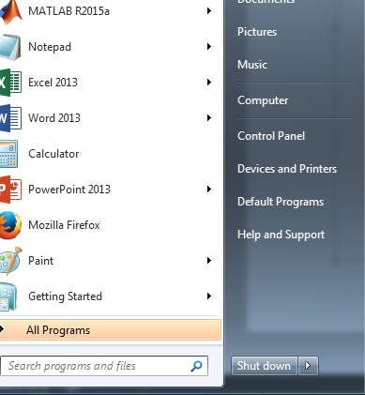
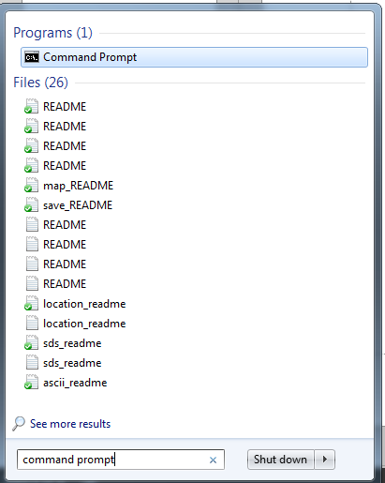
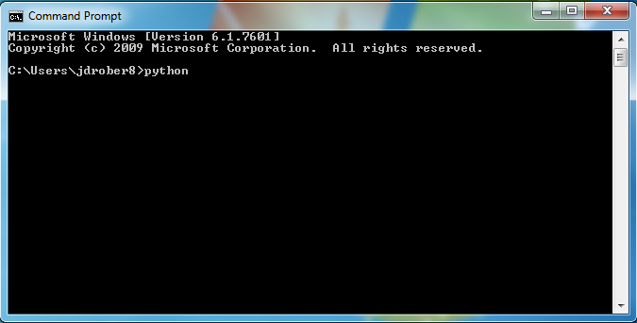
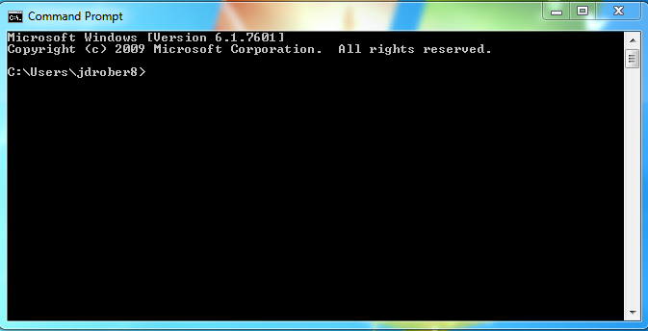
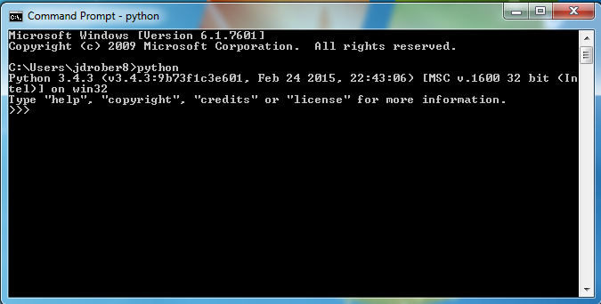
Test Python installation
Open the start menu:
Open Command Prompt
Type “python”…
…and hit Enter
If your command prompt now says: “Python 3.4.3”, you’ve completed the tutorial correctly! If not, you may have missed something…
Search here for “Command prompt”

Slide 18
Installing Python 3 Packages
Python Package Index: Pip command
https://pypi.python.org/pypi/

Slide 19
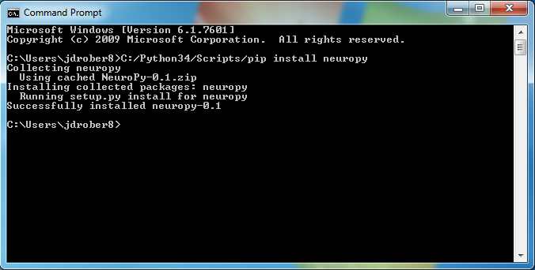
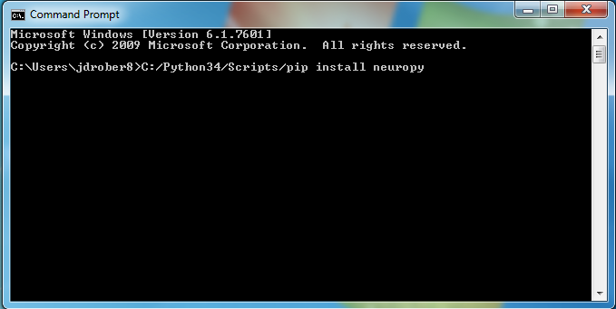
Open the Command Prompt
Many python packages are available for installation through the simple “pip” command.
Try the following command:
C:/Python34/Scripts/pip install “name-of-package” (i.e. NeuroPy)
And hit Enter.

Slide 20
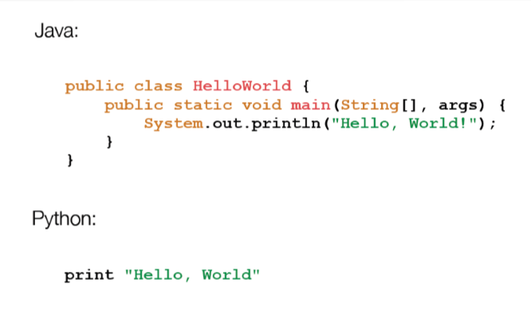
Java vs Python

Slide 21
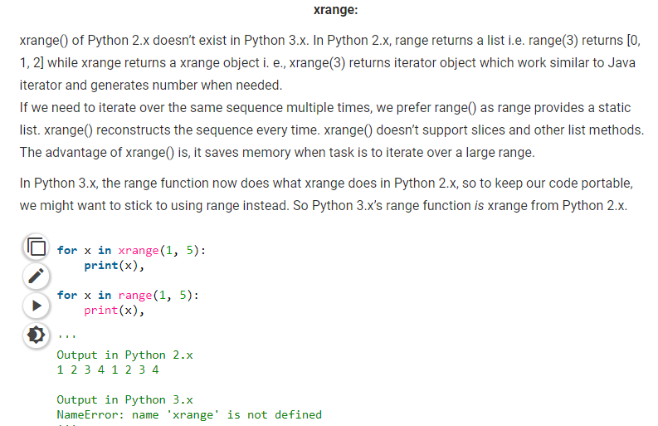
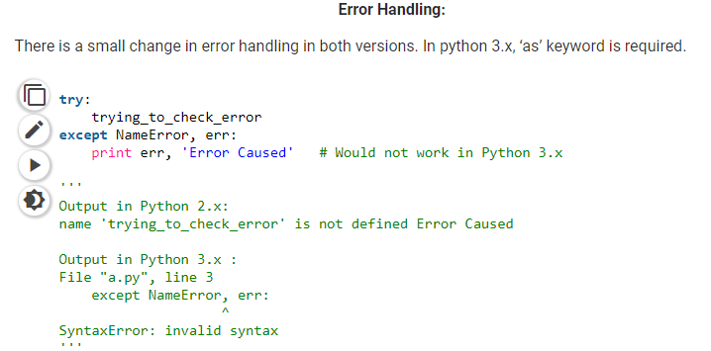
Python2 or Python3
The most visible difference is probably the way the “print” statement works.
In python2 it’s a statement print “Hello World!”
In Python3 it’s a function print(“Hello World!”)

Slide 22
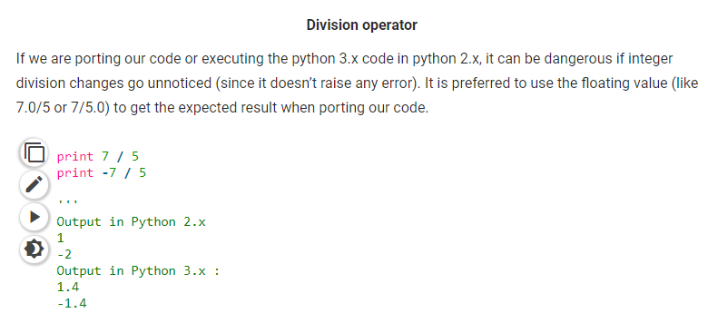
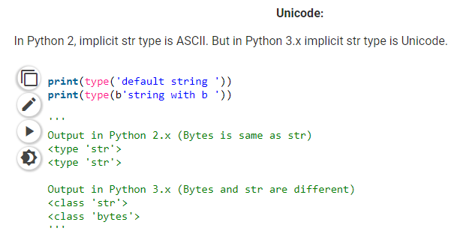
Python2 or Python3 contd..
For more kindly refer :- https://media.readthedocs.org/pdf/portingguide/latest/portingguide.pdf

Slide 23
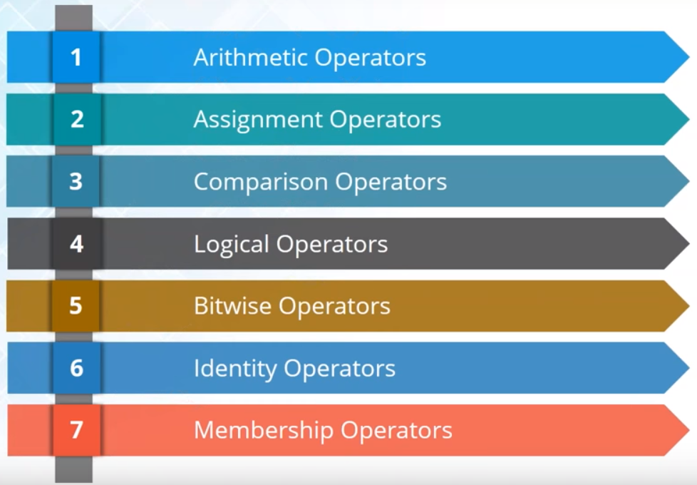
Operators in Python:

Slide 24
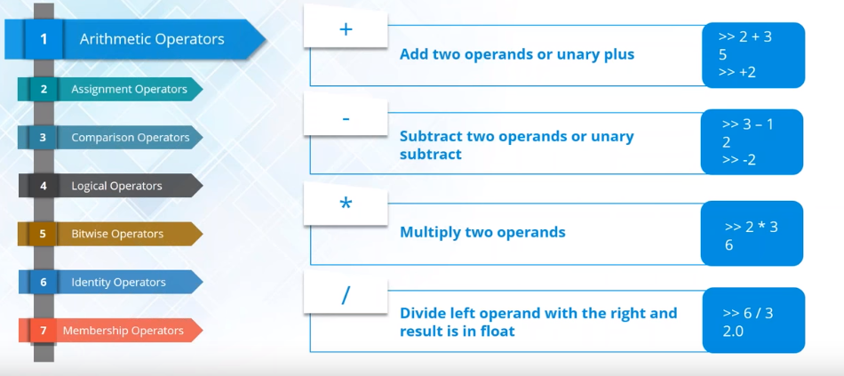
Arithmetic Operators
.

Slide 25
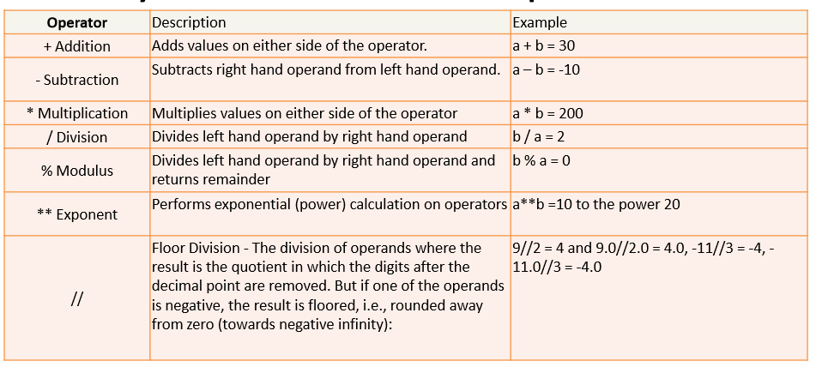
Arithmetic Operators.. contd

Slide 26
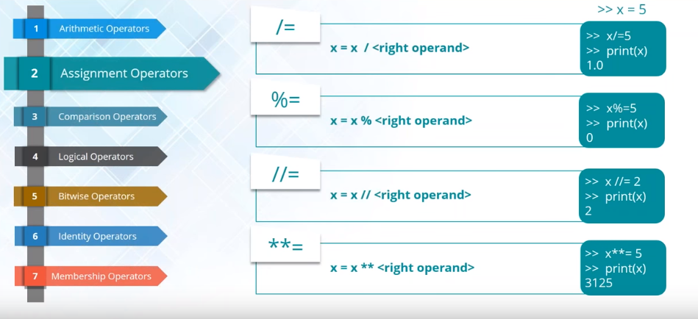
Assignment Operators
.

Slide 27
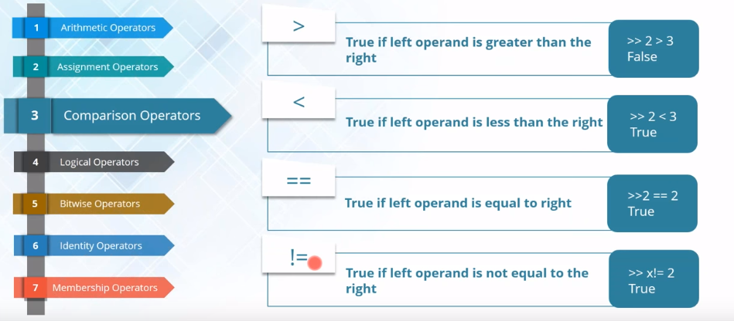
Comparison Operators
.

Slide 28
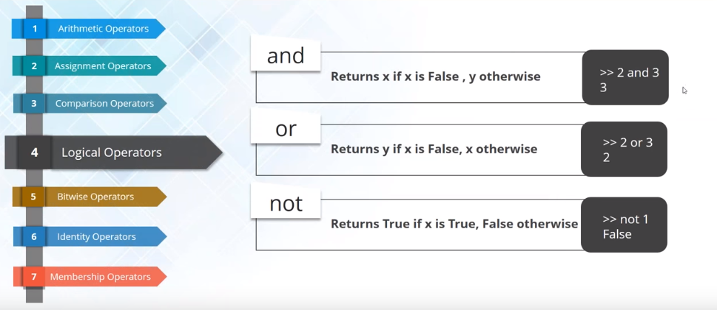
Logical Operators
.

Slide 29
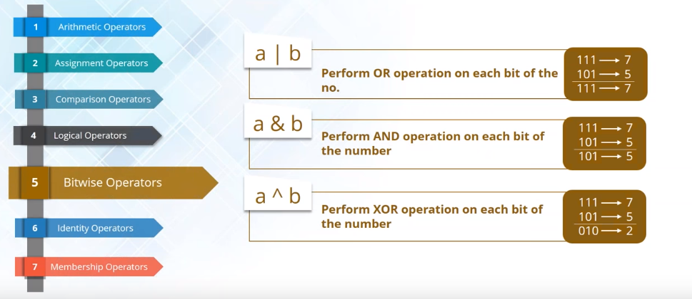
Bitwise Operators
.

Slide 30
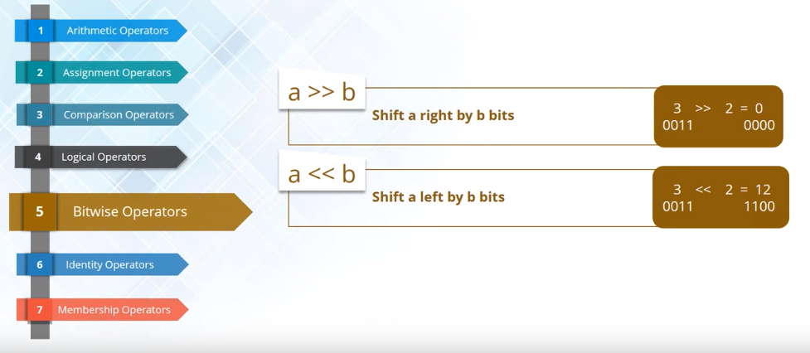
Bitwise Operators Cont…
.

Slide 31
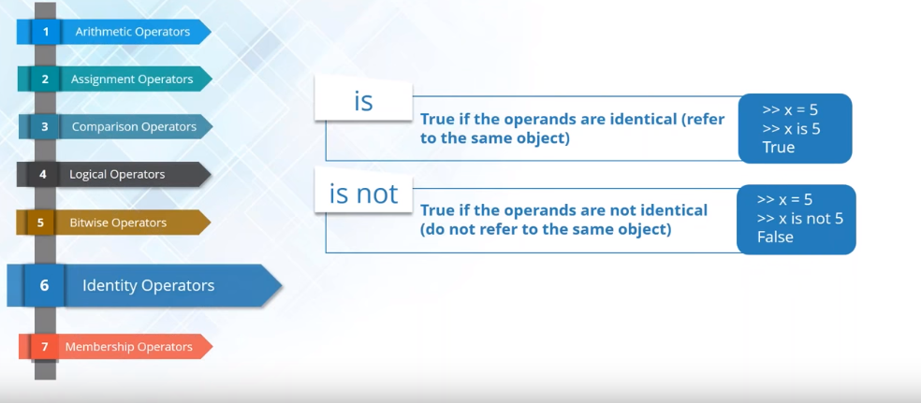
Identity Operators:
.

Slide 32
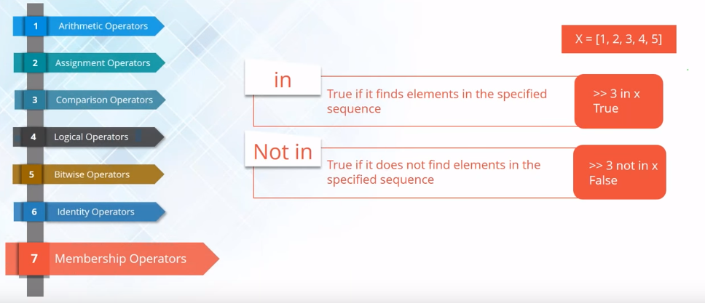
Membership Operators:
.

Slide 33
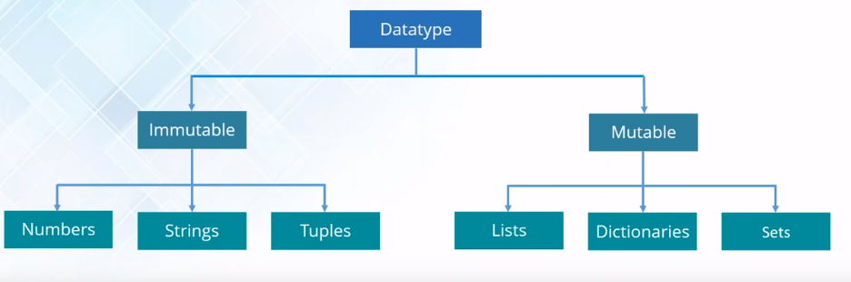
Datatype:
. Python is loosely typed language. Therefore no need of define the data type of variables
No need to declare variables before using them

Slide 34
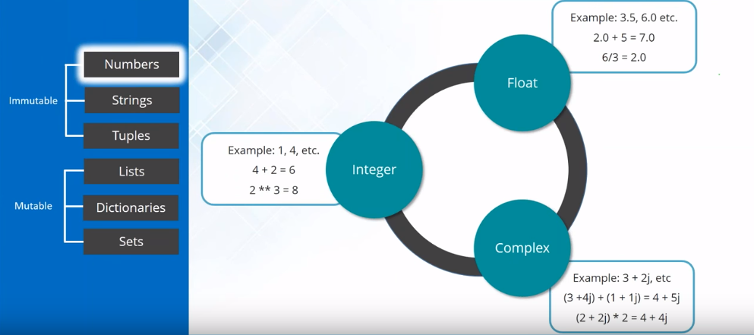
Datatype Cont…
.

Slide 35
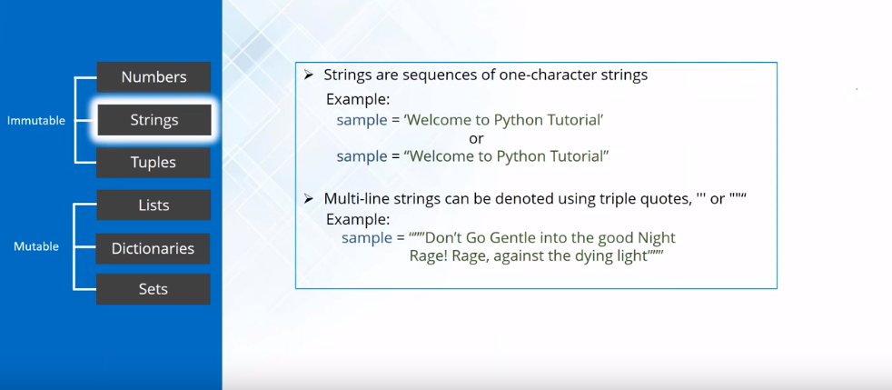
Datatype Cont…
.
Note: In most of other languages like C, C++,Java, a single character with in single quotes is treated as char data type value. But in Python we are not having char data type. Hence it is treated as String only. Eg: >>> ch='a'
>>> type(ch) <class 'str'>

Slide 36
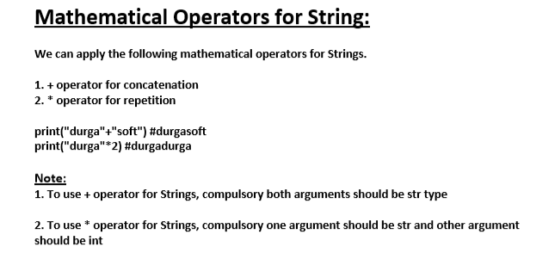
String Sequence Operations:
.
Concatenation (+)
Repetition(*)
Slicing [start:end]
Indexing [Position]

Slide 37
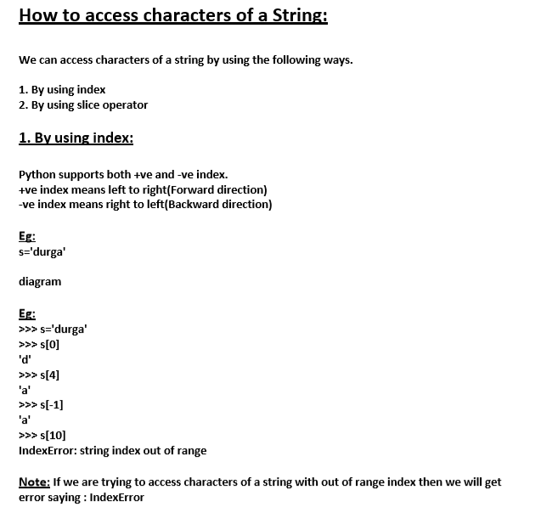
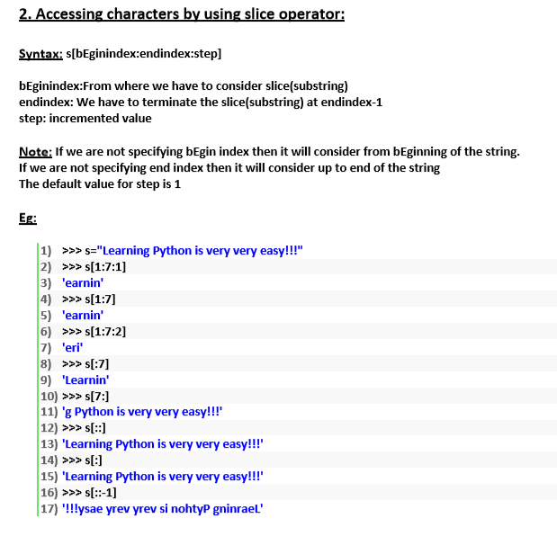
Access String Characters

Slide 38
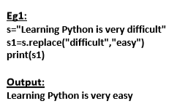
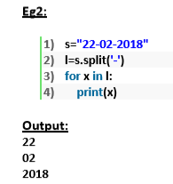
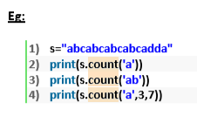
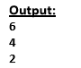
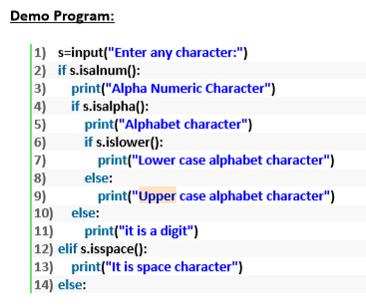

String Type Specific Method:
.
find()
replace()
split()
count()
upper()
max()
min( )
Isalpha()

Slide 39

Datatype Cont…
.

Slide 40


Tuples Explained

Slide 41

Tuple Operations:
.

Slide 42


Tuple Functions

Slide 43

Datatype Cont…
.

Slide 44



Slide 45



Access List Elements

Slide 46

List Operations:
.

Slide 47

List Operations
.

Slide 48

Tuple vs List

Slide 49

Datatype Cont…
.

Slide 50

Dictionary Methods
.

Slide 51


Dictionary

Slide 52


Dictionary Operations

Slide 53

Dictionary Methods
.

Slide 54


Test Your Skills

Slide 55

Datatype Cont…
.

Slide 56

Set Methods
.

Slide 57


Set Data Structure
If we want to represent a group of unique values as a single entity then we should go for set.
Duplicates are not allowed.
Insertion order is not preserved. But we can sort the elements.
Indexing and slicing not allowed for the set.
Heterogeneous elements are allowed.
Set objects are mutable i.e. once we creates set object we can perform any changes in that object based on our requirement.
We can represent set elements within curly braces and with comma separation
We can apply mathematical operations like union,intersection,difference etc on set objects.

Slide 58

Examples

Slide 59


Test Yourself..

Slide 60

Test Yourself…

Slide 61

Flow Control Cont…
.

Slide 62

Flow Control
.

Slide 63

Flow Control Cont…
.

Slide 64


Flow Control Cont…
.

Slide 65

Test Yourself..

Slide 66

Test Yourself…

Slide 67

Flow Control Cont…
.

Slide 68


Flow Control Cont…
.

Slide 69


Flow Control Cont…
.

Slide 70


Flow Control Cont…
.

Slide 71


Flow Control Cont…
.

Slide 72


Pass keyword

Slide 73

Function
.

Slide 74
Function Cont…
A Function is set of instruction that is used to perform a single repeated operation
Functions are:
> Organized > Re-usable
> Modularized
Python has built in functions like print(),input(),int(),len(), etc. but you can also create your own functions
There functions are called user-defined Functions
Syntax:
def name(param1, param2 …….paramN):
Statements… return [ expression ]
.

Slide 75

Defining and calling a Function:
.

Slide 76



Examples & ‘Return’ value from function…

Slide 77

Returning multiple values from a function

Slide 78

Self-Notes (Logical Diagram)

Slide 79

Function (Local and Global Variable):
Local Variables:
The variable defined within the function has a local scope and hence they are called local variables.
Local scope means they can be accessed within the function only
They appear when the function is called and disappear when the function exits
Global Variables:
The variable defined outside the function has a global scope and hence they are called global variables.
Global scope means they can be accessed within the function as well as outside the function
The value of the global variable can be used by referring as global inside a function
.

Slide 80



Example (Local vs Global)

Slide 81


Various Form of Function Arguments:
It is possible to define a function with a variable number of argument
You can call a function by using the following arguments:
Position Argument -> Arguments passed should match the function parameter from left to right
Default Argument Values -> We can assign default value for arguments to receive if the call passes too few values
.

Slide 82

Various Form of Function Arguments:
Keyword Argument -> We can call a function by specifying the keyword argument in the form argument name = value
.

Slide 83
Various Form of Function Arguments:
Arbitrary Argument List -> You may need to process a function for more arguments than you specified while defining the function.
These arguments are not named in the function definition. They are used when you need to pass more arguments that you have specified while defining the function. To add an arbitrary argument in the function definition , start the variable name with * or **
>>> def fun(*arr)
>>> def fun(**arr)
.

Slide 84

Test Yourself..

Slide 85


Lambda Function
.
A simple one line function
Do not use def or return keywords. These are implicit

Slide 86

Example (Lambda function)

Slide 87

Map Example:
Apply same function to each element of a sequence
Return the modified list
.

Slide 88

Map Example:
.

Slide 89

Map (on Multiple Lists)

Slide 90

Filter Function:
Filter items out of a sequence
Return the filtered list
.

Slide 91

Filter Function:
.

Slide 92

Reduce Function:
Applies same operation to items of a sequence
Uses result of operation as first param of next operation
Returns an item, not a list

Slide 93


Reduce Function:

Slide 94

File Handling & I/O Method
.

Slide 95


Mode of opening a file
.

Slide 96

The File Attribute:
.

Slide 97

Common File Methods:
.

Slide 98

File Handling Examples

Slide 99

Examples Contd..

Slide 100
Common File Methods:
.

Slide 101

Handling CSV Files

Slide 102

Exception Handling
In any programming language there are 2 types of errors are possible.
1. Syntax Errors 2. Runtime Errors

Slide 103
Errors and Exception Handling :
What is an Exception?
An Exception is an error that happens during execution of a program. When that error occurs , Python generates an exception that can be handled, which avoids your program to crash
Why use Exceptions?
Exception are convenient in many ways for handling errors and special conditions in program. When you think that you have a code which can produce an error then you can use an exception
You can raise an exception in your own program by using the raise exception statement.
Raising an exception breaks current code execution and returns the exception back until it is handled.
.

Slide 104
Common Exception Errors
IOError
>> If the file cannot be opened
ImportError
>> If python cannot find a module
ValueError
>> Raised when a built-in operation or function receives an argument that has the right type but an inappropriate value
KeyboardInterrupt
>> Raised when use hits the interrupt key (normally ctrl+c or delete)
EOFError
>> Raised when one of the built-in functions(input() or raw input()) hits an end-of-file condition(EOF) without reading any data.
.

Slide 105

Python's Exception Hierarchy

Slide 106

Exception v/s Non-Exception Handling
It is highly recommended to handle exceptions.
The code which may raise exception is called risky code and we have to take risky code inside try block.
The corresponding handling code we have to take inside except block.
try:
Risky Code
except XXX:
Handling code/Alternative Code

Slide 107

Common Exception Errors
Program without Error Handling
.

Slide 108

Common Exception Errors
Program with Error Handling
.

Slide 109

try..except..else Clause
The else clause in a try, except statement must follow all except clauses
It is useful for code that must be executed if the try clause does not raise an exception
try:
data = something_that_can_go_wrong
except IOError:
Handle the exception error
else:
Doing_different_exception_handlining
.

Slide 110

Multiple Exceptions Handling in Python

Slide 111


Single except block can handle multiple exceptions
Default except block:

Slide 112


Test Yourself

Slide 113

Assert Statement:
The Assert statement is intended for debugging statements
It raises an exception as soon as the condition is false
The caller gets an exception which will go into stderr or syslog
assert <some_test_> ,<message>
The line above can be “read” as : if <some_test> evaluates to False , an exception is raised and <message> will be output
>>> if not condition:
raise AsstionError()
Example: We have a loop which can result wrong if the value of i>=9. Hence we can use assert statement here
.

Slide 114



Example (Assert)

Slide 115

Ignore Errors:
Errors can be ignored without handling them in the program. We can do it using pass in except block of error handling section like below.
-> try:
data = something_that_can_go_wrong
->except:
pass
.

Slide 116

Built-in Functions:
Built-in functions are the functions which are built into (already available) Python and can be accessed by end-users.
Some common built-in functions:
.

Slide 117
REGULAR EXPRESSIONS:
A Regular Expression (abbreviated Regex or Regexp) is a sequence of characters that forms a search pattern, mainly to use in pattern matching with strings, or string matching, i.e: “find and replace” –like operations
Each character in a regular expression is either a meta-character with its special meaning, or a regular character with its literal meaning.
RE(Regular Expression) is supported by many programming languages incluing Python
Python uses built-in “re” module for RegExp work
.

Slide 118
Why RE?
RE are portable (almost same syntax in all languages)
They can help you to write shorter code and saves time
Regular Expressions are fast
Use regular expressions to:
Search a string (Search and Match)
Replace part of a string (sub)
Break strings into smaller pieces (split)
.

Slide 119
Why RE?
RE are portable (almost same syntax in all languages)
They can help you to write shorter code and saves time
Regular Expressions are fast
Use regular expressions to:
Search a string (Search and Match)
Replace part of a string (sub)
Break strings into smaller pieces (split)
.

Slide 120
Basic Syntax:
Most characters match themselves
>> The regular expression “test” matches the string ‘test’ , and only that string
[ x ] matches any one of a list of characters:
>> “[abc]” matches ‘a’,’b’,’c’
[ ^x ] matches any one character that is not included in x
>> “[^abc]” matches any ingle character except ‘a’,’b’,’c’
>> “.” matches any single character
Parentheses can be used for grouping
>> “(abc)+” matches ‘abc’,’abcabc’,’abcabcabc’ etc
.

Slide 121
Basic Syntax:
x|y matches x or y
>> “here|there” matches ‘here’ and ‘there’ , but not ‘herethere’
x* matches zero or more x’s
>> “d*” matches ‘ ’,’d’,’dd’,’ddd’,etc
x+ matches one or more x’s
>> “d*” matches ’d’,’dd’,’ddd’,etc
x? Matches zero or one x’s
>> “d?” matches ‘’,or ‘d’
X{m,n} Matches I x’s , Where m<=i=<n
>> “d{2,3}” matches ‘dd’,or ‘ddd’
.

Slide 122
Basic Syntax:
“\d” matches only digit; “\D” matches any non-digit
“\s” matches any whitespace character; “\S” matches any non-whitespace chars
“\w” matches any alphanumeric character; “\W” – non-alphanumeric character
“^” matches the beginning of the string; “$” matches the end of the string
“\b” matches a word boundary;“\B” matches position that is not a word boundary
.

Slide 123
Basic Functions of RE:
Basic functions of Regular Expressions are:
re.search()
re.match()
findall
re.sub()
re.compile()
.

Slide 124


Search and Match:
Basic functions of Regular Expressions are:
>> re.search -> Search looks for a pattern anywhere in a string
>> syntax: re.search(pattern,string)
>> re.match -> Match looks for a match starting at the beginning of the string
>> syntax: re.match(pattern,string)
The function returns nothing if the match fails, else returns a Match Object.
.

Slide 125

Match Object:
An Instance of the match class with the details of the match result
The below operations can be done on a match object
.

Slide 126


Findall() Function
Findall() finds *all* the matches and returns them as a list of strings, which each string representing one match
Similarly it can be applied on files (No need to iterate over lines to find a match)
.

Slide 127

Findall() Function
Similarly it can e applied on files (No need to iterate over lines to find a match)
>> Content Present in fie1
Reading the file and finding the Gmail account
.

Slide 128


re.sub() and re.compile()
re.sub() -> Used to replace substrings
Syntax: re.sub(pattern,repl,string)
re.compile() -> When we compile a regular expression pattern into pattern objects, which can be used for matching. - Using a pattern object and reusing it is more efficient when the expression is used multiple times in a single program
.

Slide 129

Database Access:
.

Slide 130
Relational Database API Specification
To Access a database, Python needs a database module
Python database modules that conform to the Python Database API (DB-API) specification can be used to access relational database from Python.
Python Database API supports a wide range of database server:
SQLite 3
MySQL
PostgreSQL
Microsoft SQL Server 2008,2013,2016 etc.
Informix
Redshift
Oracle
Sybase
.

Slide 131
Common Things Across DBs
Connections
>> Every database module provides a module-level function connect(parameter)
>> The Exact parameters depend on the database
>> Example:
conn=connect(dsn=“”hostname:DBNAME”,user=“ramesh”,password=“Passwd12”)
If successful, a connection object (here conn) is returned
Following methods can be called using the connection object:
-c.close():
-c.commit():
-c.rollback():
-c.cursor() : Creates a new cursor object that uses the connection, A cursor is an object you can use to execute SQL queries and obtain results
.

Slide 132
More on Cursor
An instance cur of a Cursor has a number of standard methods and attributes:
>>cur.close(): Closes the cursor , Preventing any further operations on it.
>>cur.execute(query[, parameters]):Executes a query or command query on the database
>>cur.ftechone():Returns the next row of the result set produced by execute()
>>cur.fetchmany([size]): Returns a sequence of result rows (e.g./ a list of tuples) . Size is the number of rows to return
>>cur.fetchall(): Returns a sequence of all remaining result rows(e.g: a list of tuples)
>>cur.rowcount : The number of rows in the last result produced by one of the execute*() methods.
.

Slide 133
SQLite DB
It is not required to install this module separately as it is being shipped by default along with Python version 2.5.x
SQLite3 is an easy to use database engine
It is very fast and lightweight , and the entire database is stored in a single disk file.
The Python standard library includes a module called “sqlite3”intended to work with this database
This module is a SQL interface compliant with the DB-API 2.0 specification.
.

Slide 134

Using SQLite
.

Slide 135
Using SQLite
.
C:\Users\310307609\Downloads

Slide 136
Database Operations Steps
Step 1 –database import {Import modules for database}
Step 2 – Open a database connection with your program using connect()
Step 3 –Creating cursor object
Step 4 -Execute SQL query
Step 5 –Fetch data from database

Slide 137

Fetch Data from DB

Slide 138

Sample Insertion in DB

Slide 139
Modules:
A Module is a python file that (generally) has only definitions of variables, functions and classes
Some python modules are written in languages other than python , Most commonly C or C++, Such a module is called an Extension Module
Importing Module:
Import modulename
.

Slide 140
sys Modules:
Common Data, Functions present in sys mod
>> sys.exit()
>> sys.argv
.

Slide 141
os and subprocess Modules:
The os and subprocess modules include code that lets python work with your operating system-they even run operating system commands
The os module in best for the following tasks:
>> Working with paths and permissions (test for accessing to a path , changing directories, changing access permissions and user/group IDs)
>> Working with files (open, close, write, truncate, create links)
The subprocess module, lets you safely interact with operating system to run commands and get information out of them
.

Slide 142
os Module:
Commonly used functions in os module:
>> os.getcwd()
>> os.chdir()
>> os.mkdir()
>> os.makedirs()
>> os.remove()
>> os.rmdir()
>> os.remvedirs()
.

Slide 143
Math Number – theoretic Functions:
math.ceil(x)
math.copysign(x,y)
math.fabs()
math.exp()
math.log(x,[, abse])
math.acos(x)
math.asin(x)
math.cos(x)
math.pi
math.e
.

Slide 144
Math Number – theoretic Functions:
To ease this task various mathematical functions are predefined and can be used using the math module
Math functions are broadly classified into:
>> Number-theoretic
>> Power and Logarithmic Functions
>> Trigonometric Functions
>> Angular Conversion
>> Hyperbolic Functions
>> Special Functions
>> Constants
.

Slide 145
Math Number – theoretic Functions:
To ease this task various mathematical functions are predefined and can be used using the math module
Math functions are broadly classified into:
>> Number-theoretic
>> Power and Logarithmic Functions
>> Trigonometric Functions
>> Angular Conversion
>> Hyperbolic Functions
>> Special Functions
>> Constants
.

Slide 146



Random:
This module implements pseudo-random number generators for various distributions
Function for integers:
.

Slide 147

Classes and Objects:
.

Slide 148

Classes and Objects:
.

Slide 149

Classes and Objects:
.

Slide 150
Classes and Objects:
.

Slide 151

Namespaces
.

Slide 152

Attributes
.

Slide 153
Bulit-in Class Attributes
.
__dict__ : Dictionary containing the class’s namespace
__doc__ : Class documentation string or None if undefined
__name : Class name
__modue__ : Module name is which the class is defined . This attribute is “__main__” in interactive mode
__bases__ : A possibly empty tuple containing the base classes , in the order of their occurrences in the base class list

Slide 154

Attribute Defined by Users:
.
Attribute defined by users:
>> Attributes are created inside the class definition
>> We can dynamically create new attributes of existing instance of a class
>> Attributes can be bound to class name as well

Slide 155

Public, Protected and Private Attributes
.

Slide 156
Public, Protected and Private Attributes
.

Slide 157
Class Variable & Instance Variables
.
Class variable are shared by all Instances
Instance variable are unique to each instance

Slide 158


Definition of Methods
.

Slide 159


Private Methods in Python:
.

Slide 160

Private Methods Cont…
If we try to access the Private method, we will get an error
Example:

Slide 161


Static Method

Slide 162

Constructor – The __init__ Method
Define the attribute of an instance right after its creation
Is immediately and automatically called after an Instance has been created
It is usually the first method of a class , i.e: it follows right after the class header
Sometimes called as Constructor

Slide 163
Constructor – The __init__ Method
Define the attribute of an instance right after its creation
Is immediately and automatically called after an Instance has been created
It is usually the first method of a class , i.e: it follows right after the class header
Sometimes called as Constructor

Slide 164

Object Oriented Programming

Slide 165

Encapsulation

Slide 166

Encapsulation (Contd.)

Slide 167

Inheritance

Slide 168

Inheritance(Contd.)

Slide 169

Inheritance in Python :

Slide 170

Polymorphism
Poly means many. Morphs means forms. Polymorphism means 'Many Forms'.
Eg1: Yourself is best example of polymorphism. In front of Your parents You will have one type of behavior and with friends another type of behaviour.Same person but different behaviors at different places, which is nothing but polymorphism.

Slide 171

Polymorphism

Slide 172

Polymorphism (Contd.)

Slide 173

Polymorphism (Contd.)

Slide 174

Polymorphism (Contd.)

Slide 175

Polymorphism (Contd.)

Slide 176

Advanced Concepts (Polymorphism)

Slide 177


Sample Example & ‘hasattr’ function

Slide 178

Special Methods:

Slide 179
Numpy
Numpy, Scipy, and Matplotlib provide MATLAB-like functionality in python.
Numpy Features:
Typed multidimentional arrays (matrices)
Fast numerical computations (matrix math)
High-level math functions
179

Slide 180
Why do we need NumPy
Python does numerical computations slowly.
1000 x 1000 matrix multiply
Python triple loop takes > 10 min.
Numpy takes ~0.03 seconds
180

Slide 181
NumPy Overview
Arrays
Shaping and transposition
Mathematical Operations
Indexing and slicing
Broadcasting
181

Slide 182
Arrays, Basic Properties
import numpy as np
a = np.array([[1,2,3],[4,5,6]],dtype=np.float32)
print a.ndim, a.shape, a.dtype
Arrays can have any number of dimensions, including zero (a scalar).
Arrays are typed: np.uint8, np.int64, np.float32, np.float64
Arrays are dense. Each element of the array exists and has the same type.

Slide 183
Arrays, creation
np.ones, np.zeros
np.arange
np.concatenate
np.astype
np.zeros_like, np.ones_like
np.random.random

Slide 184
Shaping
a = np.array([1,2,3,4,5,6])
a = a.reshape(3,2)
a = a.reshape(2,-1)
a = a.ravel()
Total number of elements cannot change.
Use -1 to infer axis shape
Row-major by default (MATLAB is column-major)

Slide 185
Python Libraries for Data Science
Pandas:
adds data structures and tools designed to work with table-like data (similar to Series and Data Frames in R)
provides tools for data manipulation: reshaping, merging, sorting, slicing, aggregation etc.
allows handling missing data

Slide 186
Reading data using pandas
#Read csv file
df = pd.read_csv("http://rcs.bu.edu/examples/python/data_analysis/Salaries.csv")
There is a number of pandas commands to read other data formats:
pd.read_excel('myfile.xlsx',sheet_name='Sheet1', index_col=None, na_values=['NA'])
pd.read_stata('myfile.dta')
pd.read_sas('myfile.sas7bdat')
pd.read_hdf('myfile.h5','df')

Slide 187

Data Frames attributes

Slide 188

Data Frames methods

Slide 189
matplotlib
A major design limitation is that it stives to emulate MATLAB
More on this in the next lecture
One important function for HW6:
plot(xvalues, yvalues)

Slide 190

…,

